Slide 1




By: Nicole Kachouh and Saahil Sharma

Slide 2
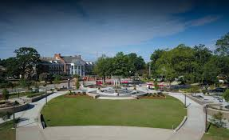
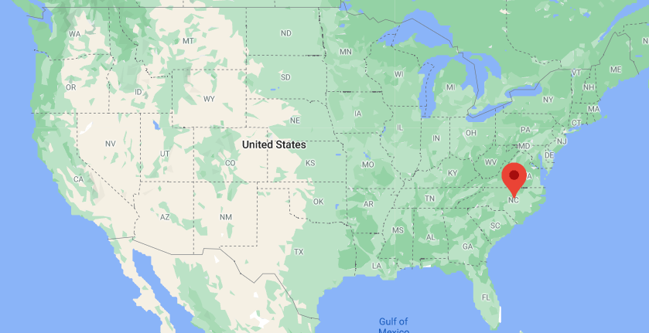
Topic Overview
Interest:
Relationship between the political, socioeconomic and demographic features in the US
Investigate this relationship on a more local level: Town of Cary (Wake County, NC)
Close connections between Cary and Federal Government
Notes:
-We have decided to investigate the relationship between different political, socioeconomic, and demographic aspects of the Town of Cary in North Carolina
-We chose to focus on these factors because in light of recent events, we wanted to investigate the correlation between political, socioeconomic, and demographic factors in a specific community. We chose Cary because we desire to investigate this relationship on a more local level, and there is an abundance of open source data regarding Cary available in many forms.

Slide 3
Data Collection Process
CPD-Incidents CSV file:
Contains data regarding all police interactions and crime reports in the Town of Cary from 1996 to 2020
We used this crime data to correlate various levels of crimes to the socioeconomic situation at the time
Cary 2020 Population Demographics Website:
According to the North Carolina State Bureau of Investigation, one of the most important crime factors is population density
We extracted information about the population of Cary to discover the correlation between population and police incidents
Voter Data for Presidential Elections:
We scraped through voter data for the US Presidential Elections in North Carolina by county from 1996
We aggregated by year to display the changes in votes for Democrat, Republican, and Independent Presidential Candidates changed in each election in Cary
Notes:
We chose the CPD-Incidents CSV file because it contains data regarding all police interactions and crime reports in the Town of Cary from 2005 to 2014, and we plan to use this crime data to correlate various levels of crimes to the socioeconomic situation at the time.
According to the North Carolina State Bureau of Investigation, one of the most important crime factors is population density, so we chose this dataset to extract information about the population of Cary to see if it is correlated with the data from the police department incidents.
Finally, we chose to scrape through voter data for the US Presidential Elections in North Carolina by county from 2000 to see how voter turnout and voter decisions changed by year.

Slide 4
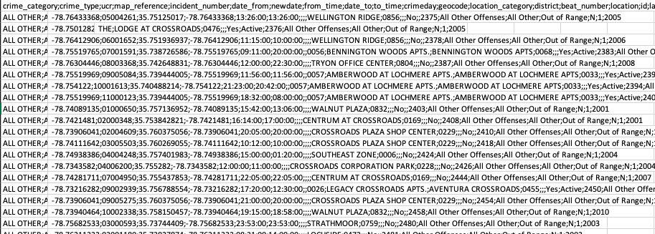
Data Cleaning Process
CPD-Incidents CSV file - BEFORE:
Notes:
In the Cary Police Department Incident CSV file, we used the Pandas module to open the CSV file and organize it into a Dataframe. This dataset had a row for every situation in which the police were called regardless of whether a legitimate crime had occurred or not. There were also about 10 columns that contained duplicate or irrelevant data across each row ("ucr", "map_reference", "date_from", "date_to", "to_time", "district", "beat_number", "location", "id", "time_to", "time_from", "neighborhd_id", "apartment_complex", "chrgcnt", "activity_date", "phxrecordstatus", "phxstatus"), so we removed them from the dataframe. After this, we realized that many of the "crime_type" reportings were from situations in which the police were called, but no criminal activity was actually involved, so we removed the rows that had a "crime_type" of "ALL OTHER" or "ALL OTHER - ALL TRAFFIC...".

Slide 5
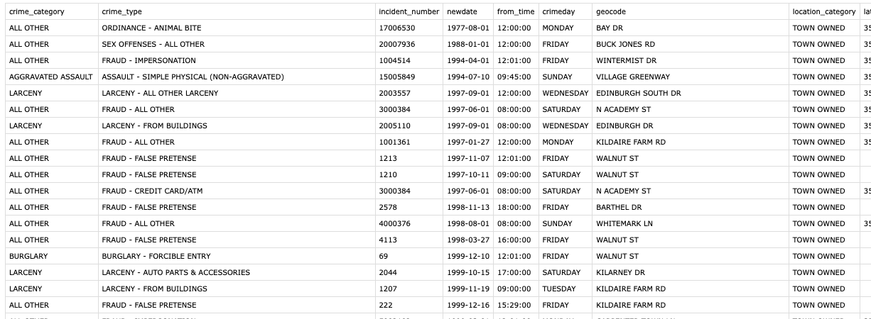
Data Cleaning Process
CPD-Incidents CSV file - AFTER:
Notes:
In the Cary Police Department Incident CSV file, we used the Pandas module to open the CSV file and organize it into a Dataframe. This dataset had a row for every situation in which the police were called regardless of whether a legitimate crime had occurred or not. There were also about 10 columns that contained duplicate or irrelevant data across each row ("ucr", "map_reference", "date_from", "date_to", "to_time", "district", "beat_number", "location", "id", "time_to", "time_from", "neighborhd_id", "apartment_complex", "chrgcnt", "activity_date", "phxrecordstatus", "phxstatus"), so we removed them from the dataframe. After this, we realized that many of the "crime_type" reportings were from situations in which the police were called, but no criminal activity was actually involved, so we removed the rows that had a "crime_type" of "ALL OTHER" or "ALL OTHER - ALL TRAFFIC...".

Slide 6
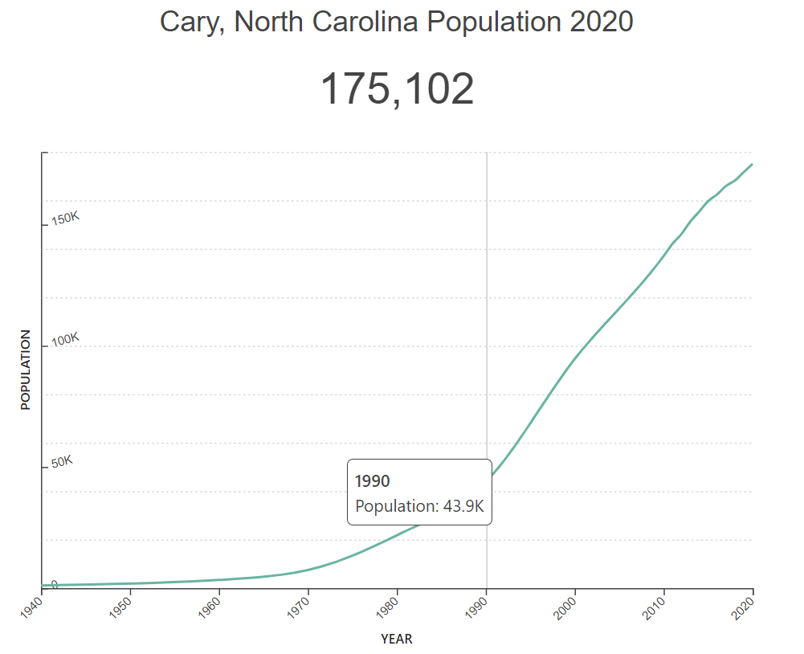
Data Cleaning Process
Cary 2020 Population Demographics Website - BEFORE:
https://worldpopulationreview.com/us-cities/cary-nc-population
Notes:
On the Cary population webpage, we used the Beautiful Soup module to scrape through the html file and extract the demographic statistics that were relevant to our analysis. This webpage contains many tables sorting the population of Cary into distributions based on factors such as by year, race, educational attainment, and poverty by race.

Slide 7
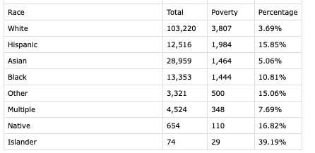
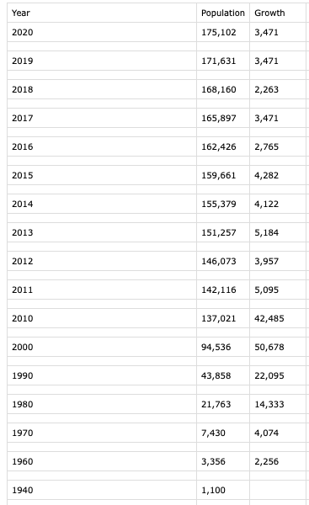
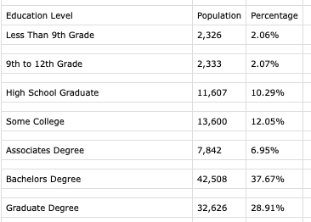
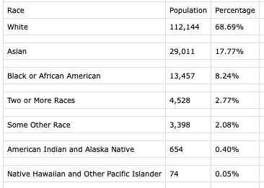
Data Cleaning Process
Cary 2020 Population Demographics Website - AFTER:
Notes:
Here are the tables we extracted from the website. They are organized by year, race, educational attainment, and poverty by race. We created a new clean file containing the population tables needed for our analysis.

Slide 8
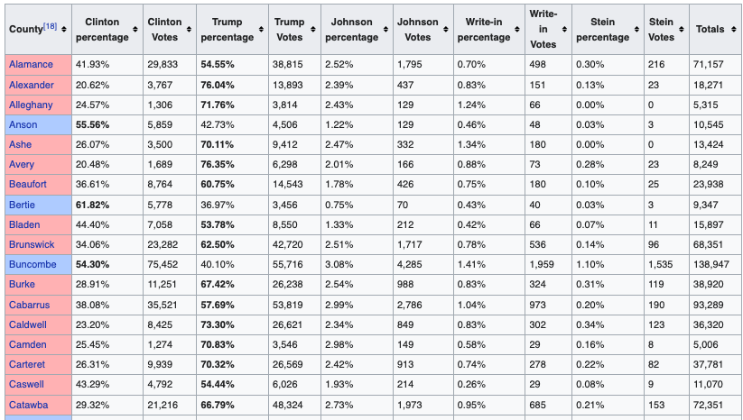
Data Cleaning Process
Voter Data for Presidential Elections - BEFORE:
For each election year, there was such a table for all the counties in NC
Notes:
For the presidential election stats, we found a central wikipedia page with links for years from 1824-2016, so we used the 1996-2016 data, so we could align it with our crime and population data. We used the Beautiful Soup module to parse through each of the links and find the table containing voting data (Democrats, Republican, Independent): each row of this table represents the stats for a county in North Carolina. We wanted to get the stats for Wake county which contains Cary, so we extracted Wake's voting stats for each election year from 1996-2016.

Slide 9
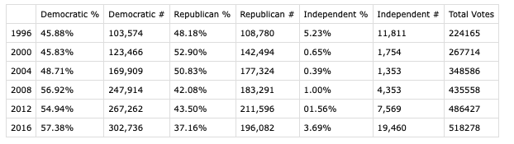
Data Cleaning Process
Voter Data for Presidential Elections - AFTER:
Notes:
Here is the dataframe we created that contains the proportion and number of Wake county residents that voted for the Democratic, Republican, and Independent candidates in each election year.

Slide 10
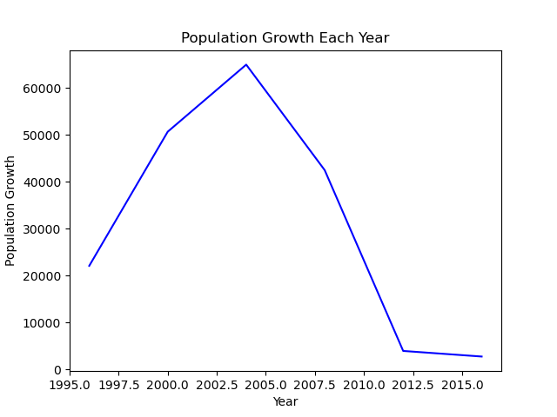
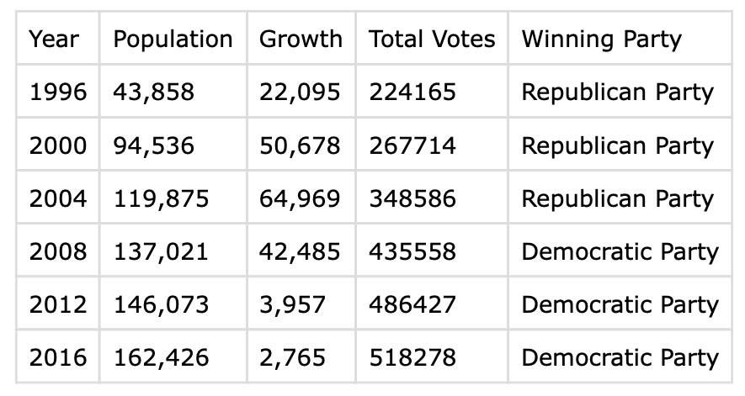
Data Analysis
Visual 1:
Insight 1:
Notes:
First, we wanted to study the relationship between the demographic and political aspects of the town of Cary
To create our first insight, we cross referenced the Wake county voter data with the Cary population data for the period 1995-2016
Now if we look at the data that we obtained, we notice a trend: for the years where the winning party in Cary was the Republican party (1996-2004), the population is growing at a much faster rate (hence the steep, positive slope) compared to the lower population growth rate when the winning party is the democratric party in the years 2008-2016

Slide 11
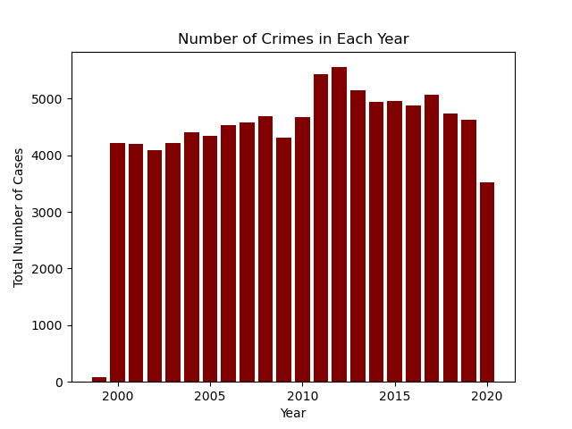
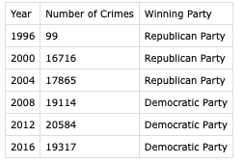
Data Analysis
Visual 2:
Insight 2:
Notes:
Secondly, we wanted to study the relationship between the voter history of the town of Cary and its crime frequency
We cross referenced the voter data with the crime frequency by year to show the correlation between voting patterns, presidential party victors, and total crime in Cary.
Now looking at the data that we gathered and plotted, we can see that there is a moderate correlation. During the years that Cary voted Republican, the crime rates were slightly lower by approximately 1000 crimes per year compared to the years that Cary voted Democrat.

Slide 12
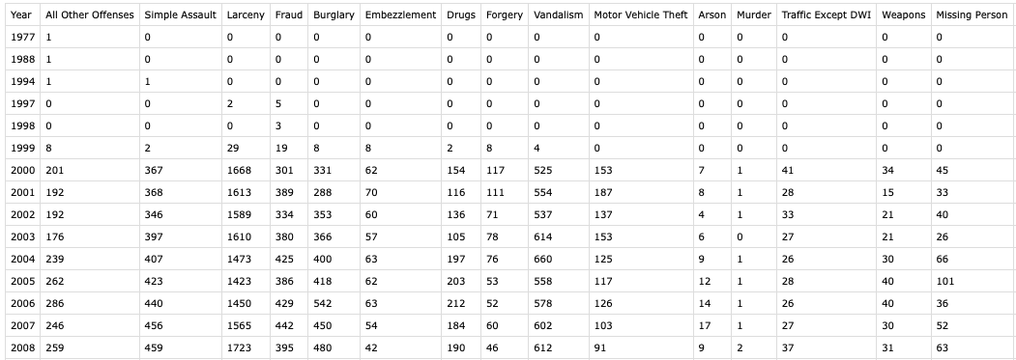
Data Analysis
Insight 3:
Notes:
Even after cleaning our the crimes csv file, there were still a lot of data that needed to be sorted in order to get some insights out of it.
We groupe the incidents by year, and showed the number of crimes for each category as well as the total number of crimes for that year
By creating this dataframe, we were then able to extract the most common crimes in the town of cary and decided to further analyze the distribution of the crimes in our fourth insight

Slide 13
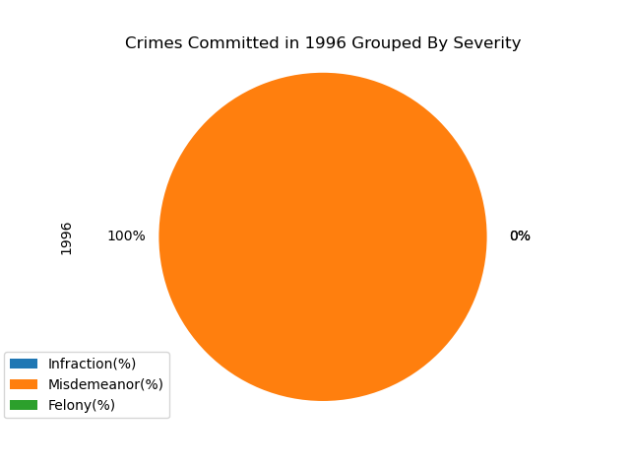
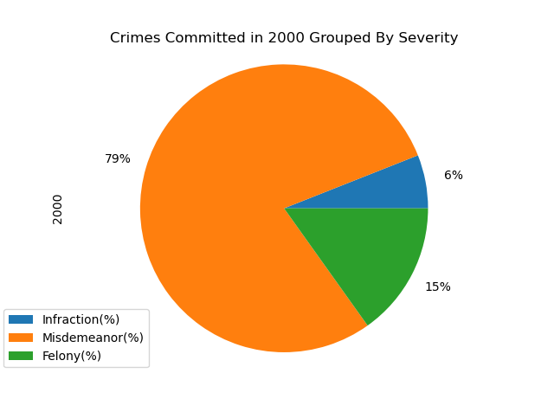
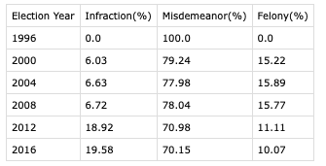
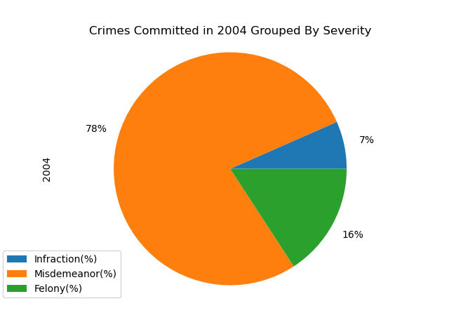

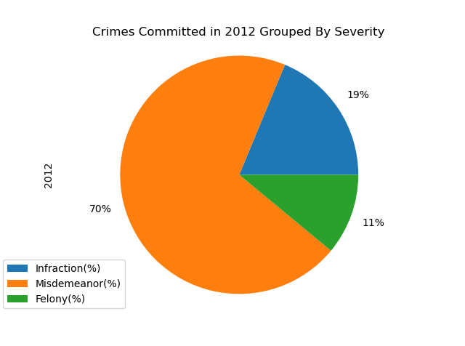
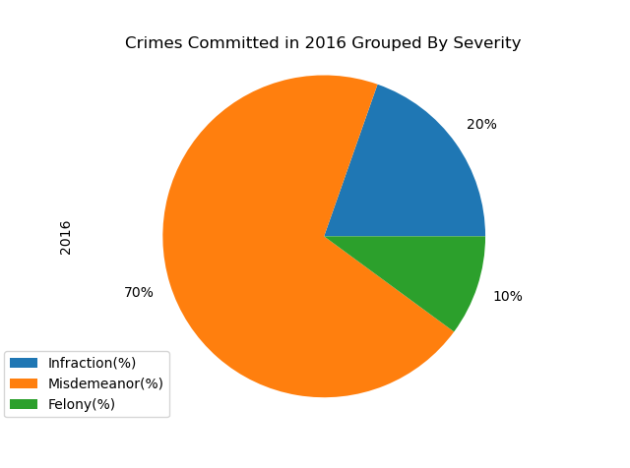
Data Analysis
Insight 4:
Notes:
Using the csv file that we created for our insight 3, we decided to classify the crime types into Infractions, Misdemeanors, and Felonies. We broke down these statistics by election year and calculated the proportional makeup of each crime category for the year. While Insight 2 showed that total crimes were relatively higher during the years that Democratic candidates won in Cary, this insight shows that the proportion of misdemeanors and felonies in Cary was higher than the proportion of infractions during the years that Republican candidates won in Cary. From this we can display that there is a strong correlation between Republican candidates winning in Cary and a higher proportion of violent crimes committed.

Slide 14
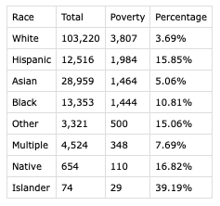
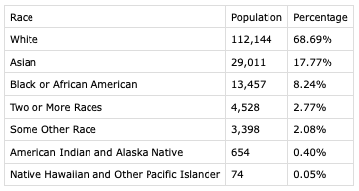
Data Analysis
Insight 5-1:
Insight 5-2:
Notes:
From the poverty by race dataframe and the population by race dataframes, we can derive some conclusions about which racial groups are more affected by poverty in Cary. While White and Asian residents make up about 87% of Cary, only 9% live in poverty. On the other hand, Black, Natives, and Pacific Islanders make up 9% of Cary, but they make up 67% of the Cary residents that live in poverty.

Slide 15
Conclusion
From our 5 insights created from 3 data sources regarding criminal,, political, and socioeconomic information about the Town of Cary, we arrive at several conclusions:
High population growth rates were associated with a Republican presidential victor in Cary, and lower growth rates were associated with a Democratic presidential victor
About 1000 more total annual crimes were committed during the years when Democratic candidates won Cary compared to the years when Republican candidates won Cary
A higher proportion of felony and misdemeanor crimes were committed during the years when Republicans won Cary, and a higher proportion of petty crimes were committed in Democrat-won years
White and Asian residents of Cary experience much lower poverty levels relative to their population size than Black, Native, and Pacific Islander residents in Cary.

